Slide 1
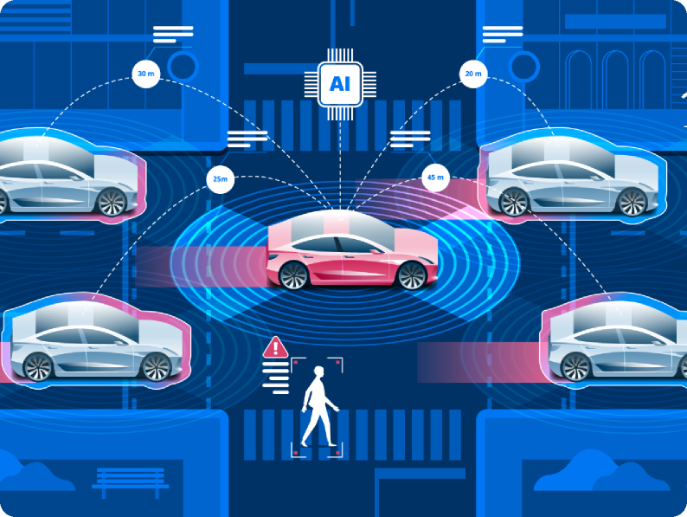
Narrative XAI Explainable UI for AI driven Driving Scenario Generation
UXD-PRNUI.2 - SS26
Concept Design
15.05.26
Work by
Supervised by
Muhmmad Minhas Shafique
Pranta Saha
Disha Shenoy
Sirine Kouissah Mahjoub
Mostafitz Rakib
Courtney Huck
Sadia Aman
Prof. Dr. Ignacio Alvarez
Atharva Mahindrakar
Notes:
“Today we are presenting our project, Narrative XAI – Explainable UI for AI-driven Driving Scenario Generation. Our project explores how AI-generated driving scenarios can become more understandable and transparent through better UX and interface design. We focus on the relationship between AI, autonomous driving, and Explainable AI or XAI. The main goal is to help users understand not only the AI decisions. In this presentation, we will briefly discuss our research, concept development, and future direction.”

Slide 2
PRANTA SAHA
1. Process Map
2. RQ & Hypotheses
3. Concept Foundations
4. The Concept
5. Research Design Sketch
6. Risks & Next Steps
7. Back matter
Agenda
2
Notes:
“Here is the agenda for today’s presentation. First, we will explain our process map and overall workflow. Then we will discuss our research questions and hypotheses. After that, we will introduce the concept foundations. Next, we will present the main concept and our proposed UI approach. We will also show some research design sketches and early design thinking. Finally, we will talk about the risks, limitations, and next steps of the project.

Slide 3
PRANTA SAHA
Process Map
01

Slide 4
PRANTA SAHA
Process Map
Current Milestone
Discover
Develop
Deliver
Literature Review
Pain Points mapped
Concept Design
4
Notes:
“This slide shows our project process divided into three phases: Discover, Develop, and Deliver. In the Discover phase, we researched literature and identified key pain points related to AI explainability. Currently, we are in the Develop phase, focusing on concept design and intuitive UX interaction. Finally, in the Deliver phase, we will create the final prototype and presentation outcome.”

Slide 5
SADIA AMAN
RQ & Hypotheses
02

Slide 6
SADIA AMAN
Research Question & Hypotheses
Research Question
How does the use of a structured LLM prompt template affect both the speed and quality of Esmini scenario generation among early-career system engineers compared to unstructured prompting?
7
Notes:
Our research question focuses on understanding how different prompting approaches influence the process of AI-driven scenario generation. Specifically, we compare structured prompt templates with unstructured free-text prompting among early-career system engineers. We want to investigate whether structured prompts can improve efficiency and scenario quality during Esmini scenario generation. The motivation behind this question comes from the pain points identified in our literature review, such as repetitive prompting, unrealistic scenarios, debugging difficulties, and lack of guidance during scenario creation. Why early engineers? We focus on early-career engineers because literature suggests they experience the gap between domain knowledge and technical implementation more strongly than experienced users.

Slide 7
SADIA AMAN
Research Question & Hypotheses
Hypothesis #1
Early-career system engineers who use a structured LLM prompt template with predefined parameters will produce Esmini-ready scenarios that meet a predefined quality threshold (as measured by a scoring rubric) in less time than those using a fill-in-the-blank prompting structure.
Tested quantitatively
8
Notes:
Our first hypothesis focuses on efficiency during AI-assisted scenario generation. We hypothesize that early-career system engineers using a structured LLM prompt template with predefined parameters will be able to generate Esmini-ready scenarios faster than users working with an unstructured free-text prompting approach. The idea behind this hypothesis is that structured prompts provide guidance and reduce ambiguity during scenario creation, which may reduce the time spent thinking, correcting errors, and reformulating prompts. To evaluate this, we define an acceptable quality threshold using a scoring rubric that measures aspects such as syntax validity, completeness, and executability of the generated scenario. This hypothesis will be tested quantitatively by measuring the task completion time for participants in both groups and statistically comparing the results.

Slide 8
SADIA AMAN
Research Question & Hypotheses
Hypothesis #1 (Efficiency)
H1: Structured prompts reduce the time required to achieve acceptable scenario quality.
IV: Prompt type(Structured vs Unstructured)
DV: Time to reach acceptable scenario quality (minutes)
9
Notes:
we break this hypothesis down into its measurable variables. In this hypothesis, the independent variable is the prompt type, where we compare structured prompting with unstructured prompting. A structured prompt includes predefined fields and gives users: guided parameters organized input sections Example:Road Type: Urban road,Vehicle Speed: 40 km/h,Pedestrian Action: Sudden crossing,Crossing Type: Zebra crossing, Scenario Goal: Safe braking response. while an unstructured prompt allows users to freely describe the scenario in natural language. like it is a blank/free-text input. example: Create a scenario where a pedestrian suddenly crosses the road in front of a moving car. For example, participants may receive the same task, such as generating a highway merging scenario. We then measure how long each participant takes to produce a valid scenario that meets the predefined quality threshold. If users with structured prompts consistently complete the task faster, this would support our hypothesis that structured prompting improves efficiency.

Slide 9
SADIA AMAN
Research Question & Hypotheses
Hypothesis #2
Early-career system engineers who use a structured LLM prompt template with predefined parameters will produce a lower proportion of semantically unrealistic Esmini scenarios than those starting from an unstructured blank prompt.
Tested quantitatively
10
Notes:
Our second hypothesis focuses on scenario quality. We hypothesize that early-career system engineers using structured LLM prompt templates will produce fewer semantically unrealistic Esmini scenarios compared to users working with unstructured free-text prompts. By semantically unrealistic scenarios, we mean scenarios that may technically run but do not represent logical or realistic driving behavior. For example, a vehicle suddenly changing lanes without sufficient distance, unrealistic pedestrian behavior, or conflicting traffic actions that would not normally happen in real driving situations. We believe structured prompts can reduce these issues because predefined parameters guide users to specify important contextual information more clearly and consistently.

Slide 10
SADIA AMAN
Research Question & Hypotheses
Hypothesis #2 (Quality)
H2: Structured prompts reduce the proportion of semantically unrealistic scenarios.
IV: Prompt type (Structured vs Unstructured)
DV: Percentage of unrealistic scenarios
11
Notes:
we identify the variables used to evaluate this hypothesis. the independent variable is again the prompt type, where we compare structured prompting against unstructured prompting. The dependent variable is the percentage of semantically unrealistic scenarios generated by participants. To measure this quantitatively, participants from both groups will generate scenarios for the same driving tasks. We will then evaluate each generated scenario using a predefined realism rubric. For example, if a participant generates 10 scenarios and 3 are classified as semantically unrealistic, the unrealistic scenario rate would be 30 percent. We can then compare the average percentage between the structured and unstructured prompt groups to evaluate whether structured prompting improves scenario realism.

Slide 11
SADIA AMAN
Research Question & Hypotheses
Hypothesis #3
Early-career system engineers who use a structured LLM prompt template with predefined parameters will report higher trust in the validity of LLM-generated Esmini scenarios than those starting from an unstructured blank prompt.
Tested quantitatively
12
Notes:
Our third hypothesis focuses on user trust in AI-generated scenarios. We hypothesize that early-career system engineers using structured LLM prompt templates will report higher trust in the validity of generated Esmini scenarios compared to users working with unstructured prompts. The motivation behind this hypothesis comes from one of the major pain points identified in our literature review, which is the lack of transparency and confidence in AI-generated outputs. Structured prompts may increase trust because they provide clearer guidance, reduce ambiguity, and make the generation process feel more predictable and understandable to users.

Slide 12
SADIA AMAN
Research Question & Hypotheses
Hypothesis #3 (Trust)
H 3: Structured prompts increase user trust in scenario validity.
IV: Prompt type (Structured vs Unstructured)
DV: User trust score (Likert scale 1-7)
13
Notes:
we break this hypothesis into measurable variables. the independent variable is again the prompt type, where we compare structured and unstructured prompting approaches. The dependent variable is the user trust score, which we measure using a Likert scale from 1 to 7. After completing the scenario generation task, participants will answer statements such as: “I trust that the generated scenario is valid,” “I feel confident using this scenario in simulation,” or “I understand how the scenario was generated.” Participants will rate these statements from strongly disagree to strongly agree. We then calculate the average trust score for each group and compare the results quantitatively to evaluate whether structured prompting improves user trust. For example, after completing the task, users rate how much they trust the generated scenario on a 1–7 scale, and we compare the average trust scores between both groups. why trust matter? In safety-critical domains such as autonomous driving simulation, users must feel confident that AI-generated outputs are valid and reliable before using them in testing or development workflows.

Slide 13
Block C - Sirine
Block C — Literature Review (12–20 slides)
Organise the review around 2–4 themes, not around individual papers. For each theme
include:
Recommended depth checkpoints (use these to self-audit):
A short theme statement (1 sentence) telling the audience what question the theme
answers.
Key works (typically 3–8 references per theme), grouped, compared, contrasted — not
summarised one by one.
Visuals that compress information: comparison tables, taxonomies, timelines, method
matrices, conceptual diagrams. Avoid wall-of-text slides.
Citations on every slide with stable bracket numbering ([12], [13], …) that resolves to
the references slide at the end.
Sub-team attribution in the footer (who reviewed which theme) so individual
contributions are visible — this matters for grading.
Have you covered foundational / seminal work, and the most recent (last 2–3 years)
work?
Have you included at least one critical comparison (table, matrix, taxonomy)?
Have you cited primary sources (papers, standards, datasets) and not only blog posts?
Have you included industry / patent / open-source artefacts where relevant?

Slide 14
NARRATIVE XAI EXPLAINABLE UI FOR AI DRIVEN DRIVING SCENARIO GENERATION | CONCEPT DESIGN
03
SIRINE KOUISSAH MAHJOUB
Concept Foundations
Notes:
Now I will present the concept foundations behind our proposed system. At this stage, we focused on understanding what existing research taught us about AI-driven scenario generation, especially when using large language models for autonomous driving simulations.

Slide 15
What the literature taught us
Free-form prompting offers flexibility but leads to inconsistent and unpredictable outputs.
Key Insights From Literature Review
→ Users need more guided interaction mechanisms
Structured prompting improves control, consistency, and reliability in scenario generation.
→ Our concept uses predefined parameters and modular inputs
Scenario decomposition improves handling of complex driving behaviors.
→ The interface separates environment, actors, behaviors, and events.
15
Notes:
One important insight from the literature is that free-form prompting gives users flexibility, but it often produces inconsistent and unpredictable outputs. This becomes problematic especially for early-career engineers who may not have advanced prompt engineering skills. Because of this, our concept introduces more guided interaction mechanisms through predefined parameters and modular inputs. Another key finding is that structured prompting improves control, consistency, and reliability during scenario generation. We also learned that breaking complex driving scenarios into smaller components improves how the system handles behaviors and interactions. That is why our interface separates elements such as environment, actors, behaviors, and events into different configurable sections

Slide 16
What the literature taught us
Users struggle to interpret and refine LLM-generated outputs.
Key Insights From Literature Review
→ The system includes previews, validation, and guided refinement.
Pipeline-based feedback loops improve scenario quality and reduce errors.
→ The workflow integrates validation and iterative correction.
16
Notes:
The literature also showed that

Slide 17



Design Principles
Structured Guidance
Transparency
User Control
Predefined parameters reduce prompt complexity and support consistent scenario creation.
Visible scenario logic and validation improve user trust and understanding.
Users can configure key simulation variables instead of relying on unpredictable outputs.
17
Notes:
Based on these findings, we defined several core design principles for our concept. The first principle is structured guidance.

Slide 18



Design Principles
Progressive Refinement
Modular Interaction
Validation-Oriented Design
Scenario generation supports iterative improvement through feedback and validation.
Breaking scenarios into components simplifies complex workflows.
Built-in readiness checks help prevent invalid or unrealistic simulations.
18

Slide 19
Target Users & Deployment Context
Deployment Context
The proposed system supports autonomous driving simulation workflows by bridging natural-language intent and executable OpenSCENARIO generation.
Natural Language Scenario
Structured Prompt Interface
LLM-Based Scenario Generation
OpenSCENARIO Output
Esmini Validation
Scenario Refinement
19
Notes:
Our proposed system is designed to support autonomous driving simulation workflows by connecting natural language descriptions with executable OpenSCENARIO generation. The workflow begins with a natural language scenario. Then, through a structured prompt interface, the system generates scenarios using an LLM, validates them in Esmini, and supports refinement if needed.

Slide 20
Target Users & Deployment Context
Target Users
Early-Career System Engineer
Characteristics
0–2 years experience
Limited OpenSCENARIO expertise
Familiar with AV concepts
Beginner-level prompt engineering skills
Current Challenges
Syntax complexity
Prompt inconsistency
Repetitive debugging
Difficulty validating outputs
System Support:
Structured parameters
Guided interaction
Validation assistance
Reduced cognitive load
20
Notes:
Our primary target users are early-career system engineers with around zero to two years of experience. These users are generally familiar with autonomous vehicle concepts, but they often have limited expertise in OpenSCENARIO and beginner-level prompt engineering skills. Some of their current challenges include syntax complexity, inconsistent prompting, repetitive debugging, and difficulty validating outputs. To support them, our system provides structured parameters, guided interaction, validation assistance, and reduced cognitive load.

Slide 21
Target Users & Deployment Context
Target Users
Intermediate / Advanced Engineers
Characteristics
Familiar with simulation workflows
More experience with prompting
Need efficient iteration workflows
Current Challenges
Time-consuming refinement
Maintaining consistency
Managing complex scenario variations
System Support
Faster configuration
Modular workflows
Reusable scenario structures
Better controllability
21
Notes:
We also considered intermediate and advanced engineers. Although they are more experienced with simulation workflows and prompting, they still face challenges related to time-consuming refinement and maintaining consistency across complex scenarios. For these users, the system supports faster configuration, modular workflows, reusable structures, and improved controllability.

Slide 22
Time Constraints
The project is conducted within a limited academic timeframe, requiring the team to prioritize core interaction concepts and evaluation goals.
Constraints & Design Considerations
Participant Recruitment
Recruiting early-career engineers with relevant simulation experience may limit the achievable study sample size.
Simulation Environment Constraints
The project is designed around the Esmini simulation environment, which restricts compatibility with other autonomous driving simulation platforms.
22
Notes:
Finally, we identified several constraints and design considerations for the project.

Slide 23
NARRATIVE XAI EXPLAINABLE UI FOR AI DRIVEN DRIVING SCENARIO GENERATION | LITERATURE REVIEW
COURTNEY HUCK
The Concept
04

Slide 24
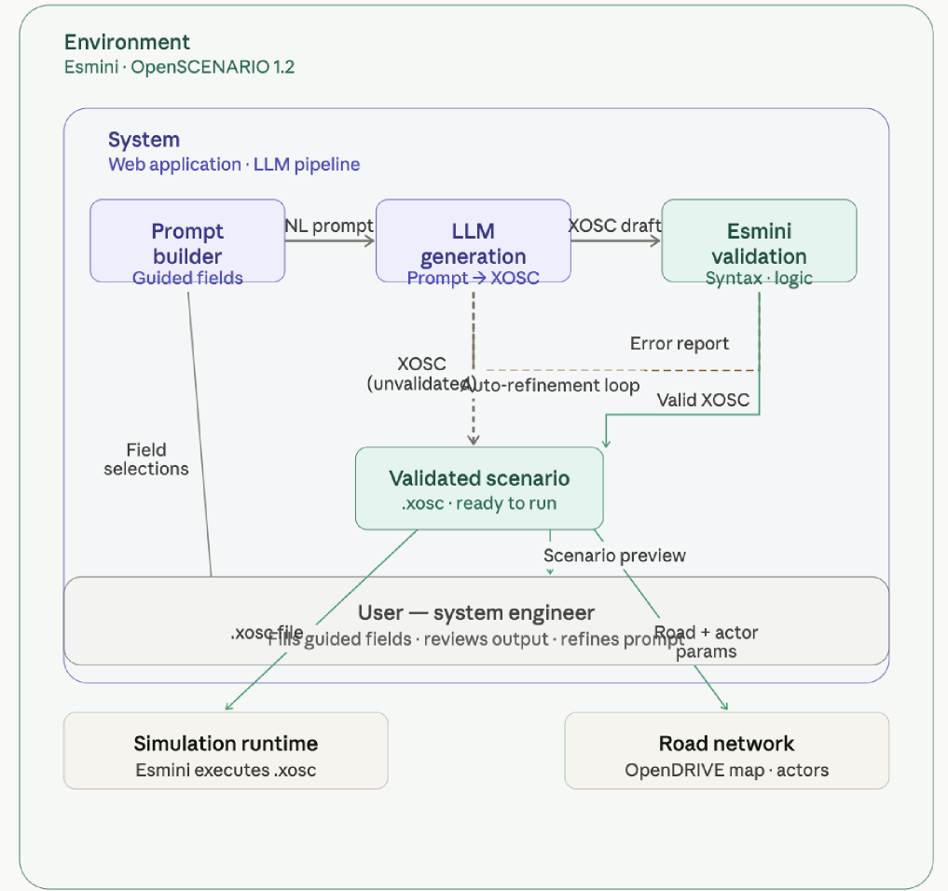
Concept Overview Diagram
Diagram generated with Claude Sonnet 4.5 (Anthropic, 2025). Content reflects authors' own design.
24

Slide 25
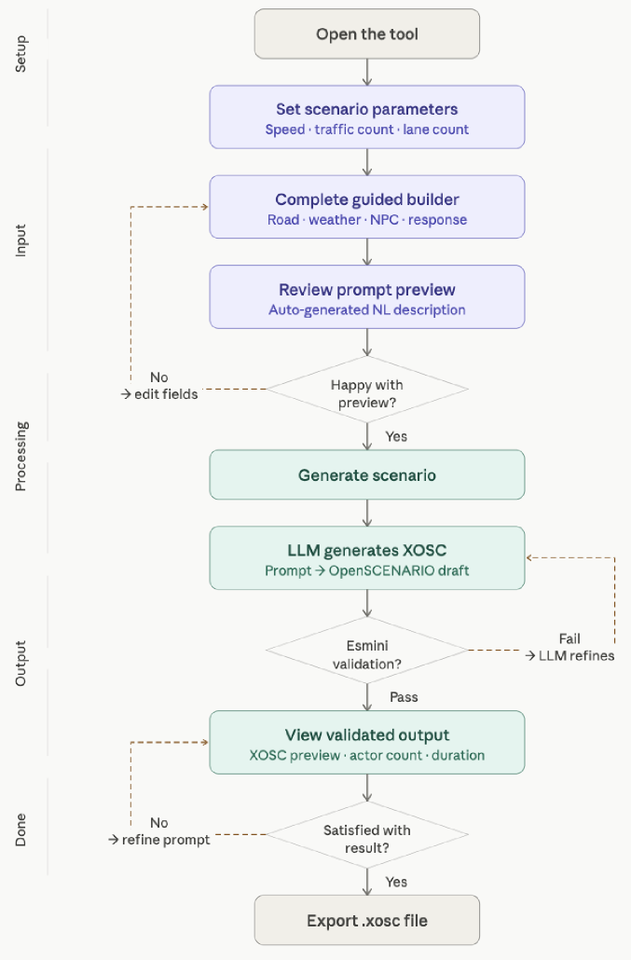
User Journey
Purple = Engineer-Driven Steps
Green = System-Driven Steps
Diagram generated with Claude Sonnet 4.5 (Anthropic, 2025). Content reflects authors' own design.
25

Slide 26
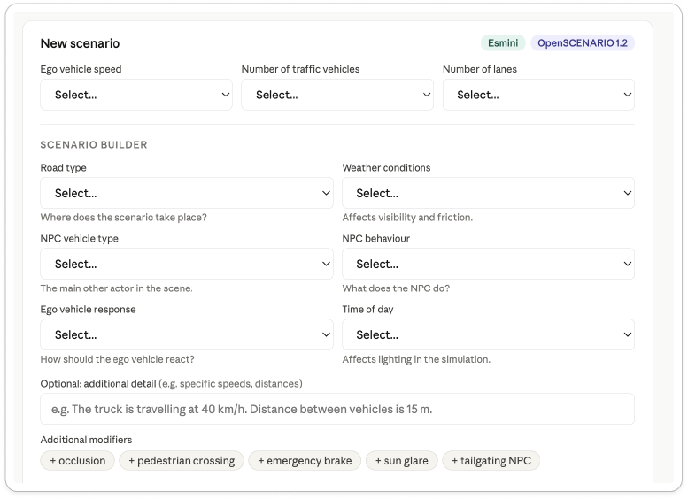



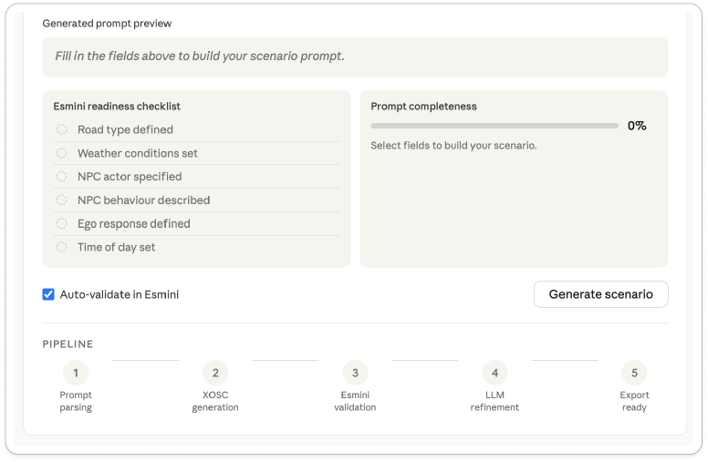
Main Parameters
User must fill out 5/6 of these parameters
Visuals of the Artifact
(Blank)
Additional possible information
Shows
Prompt
Diagram generated with Claude Sonnet 4.5 (Anthropic, 2025). Content reflects authors' own design.
Confirms if prompt will run in Esmini or not
26
Notes:
https://claude.ai/share/e74d82a6-e08d-4531-af8b-c2574e2acfe2

Slide 27
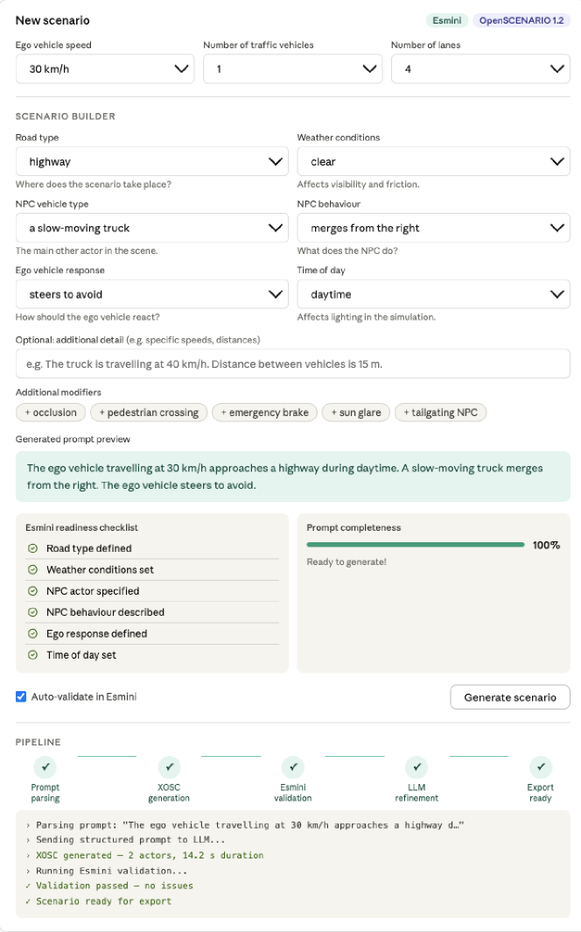

Main Parameters
User must fill out 5/6 of these parameters
Visuals of the Artifact
(Filled In)
Additional possible information
Shows
Prompt
Diagram generated with Claude Sonnet 4.5 (Anthropic, 2025). Content reflects authors' own design.
Confirms if prompt will run in Esmini or not
27

Slide 28
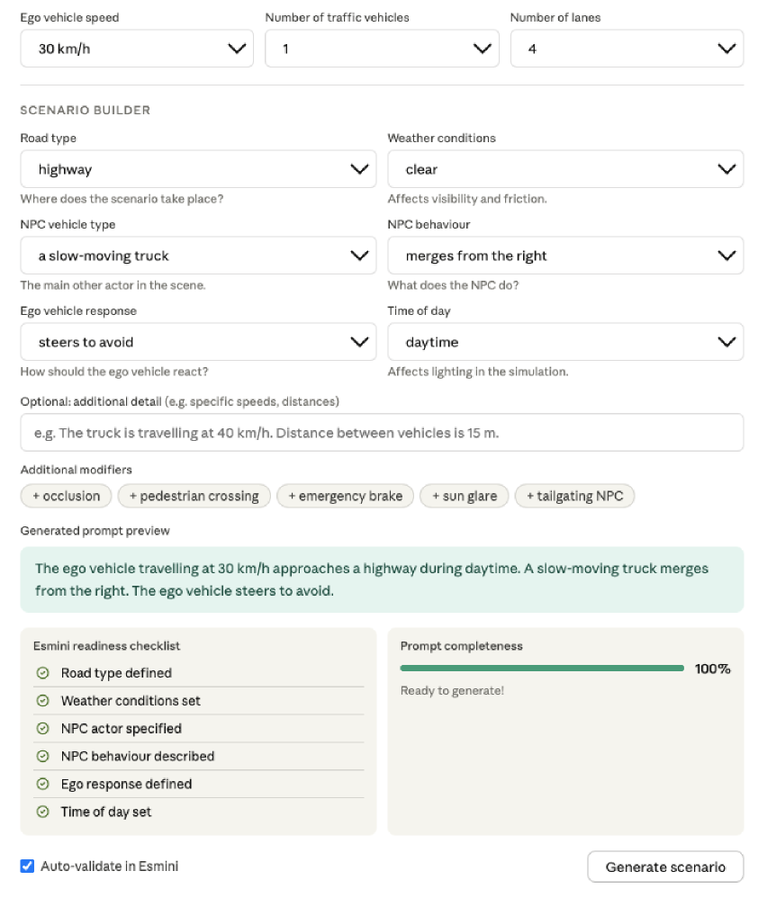
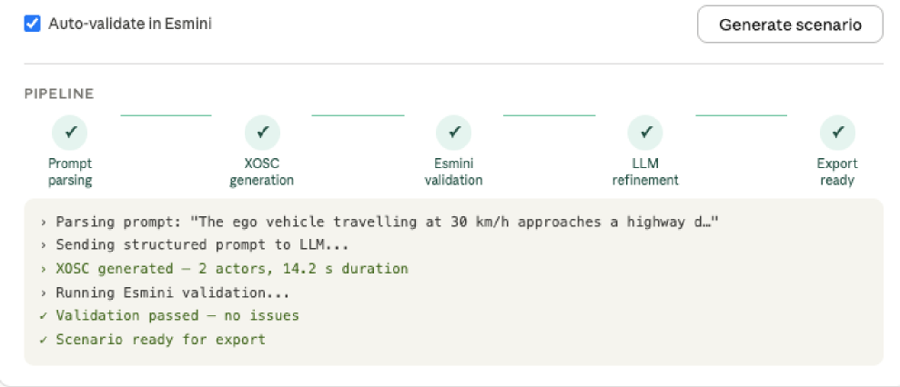
Visuals of the Artifact
(Close Up - Filled In)
Additional possible information
User must fill out 5/6 of these parameters
Shows
Prompt
Diagram generated with Claude Sonnet 4.5 (Anthropic, 2025). Content reflects authors' own design.
28

Slide 29
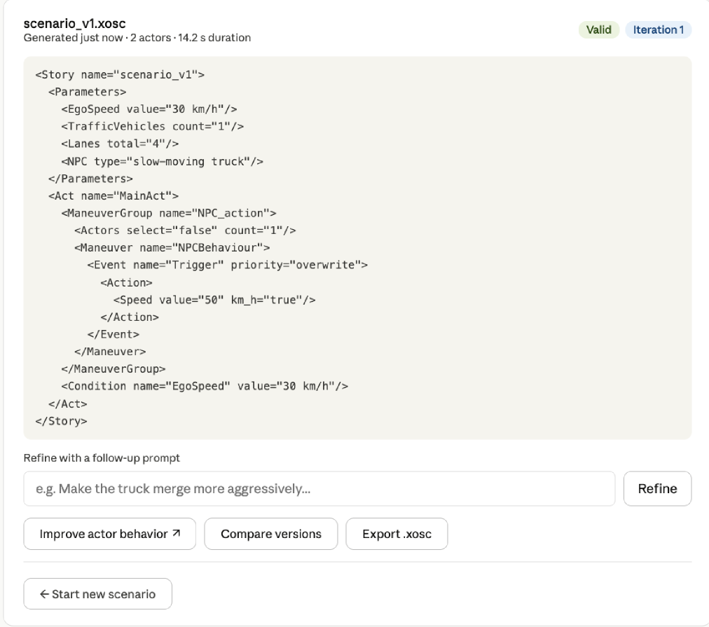
Once the engineer is happy with their prompt, they can export the XOSC file to Esmini
Visuals of the Artifact
(XOSC File)
Diagram generated with Claude Sonnet 4.5 (Anthropic, 2025). Content reflects authors' own design.
29

Slide 30
Core Mechanics
1. Structured prompt decomposition (guided builder fields)
Instead of the engineers writing freeform prompts, the interface decomposes the scenario into discrete components — road type, weather, NPC type, NPC behavior, ego response, and time of day.
Text2Scenario (2025) found that decomposing complex traffic scenarios into components before passing them to an LLM significantly improved output quality and consistency. [5]
30

Slide 31
Core Mechanics
Live preview as immediate feedback
The auto-generated prompt preview updates in real time as the engineer fills in fields, giving them a readable natural language sentence before anything is sent to the LLM.
The CHI 2025 "Prototyping with Prompts" paper identified limited model interpretability as a key frustration for professionals working with LLMs in teams. Live preview directly addresses this by making the prompt transparent and legible before submission. [3]
31

Slide 32
Core Mechanics
Readiness checklist as a nudging strategy
The Esmini readiness checklist (the six ticked/unticked items) is a nudge that draws attention to missing elements without blocking the user. The completeness progress bar reinforces this.
The "Prompt-with-Me" (2025) paper showed that structured prompt management with explicit taxonomies reduces repetitive effort and improves prompt quality. [4]
32

Slide 33
Core Mechanics
4. Closed-loop validation with auto-refinement
When Esmini validation fails, the interface automatically re-routes to the LLM for a refinement pass rather than surfacing a raw error to the engineer.
OmniTester (2024) validated this closed-loop pattern as a central architectural strategy. It introduced a self-improvement mechanism specifically to reduce hallucination and improve scenario quality without requiring manual intervention from the user. [2]
33

Slide 34
Core Mechanics
5. Pipeline status transparency
Making each pipeline step (parsing → generation → validation → refinement → export) visible to the user is a trust-building feedback modality.
The 2025 AV Testing Survey notes that LLMs are used to translate natural language into structured information for downstream generation — making that translation visible step-by-step helps engineers understand where in the loop a failure occurred, which is especially important for the system engineers our tool targets who need auditability. [1]
34

Slide 35
Mapping to Efficiency Hypothesis
Structured Parameter
Dropdowns
Quick-insert chips
Live prompt preview
Eliminates the time spent deciding what information is required. Engineers select from predefined values instead of recalling and typing scenario parameters from scratch.
One-click insertion of common scenario modifiers removes the need to recall and type Esmini-compatible terminology, cutting time spent on phrasing.
Engineers verify their intent before generating, reducing failed attempts and the iterations needed to reach a valid scenario.
Validation errors are patched by the LLM automatically rather than returned raw to the engineer, removing the time cost of manual error interpretation and re-prompting.
Auto-refinement
Loop
35

Slide 36
Mapping to Quality Hypothesis
Predefined parameter
dropdowns
Guided scenario
builder fields
Live prompt preview
Assembles the scenario into a readable sentence before generation, allowing engineers to spot semantic contradictions — before the LLM processes it.
Constrains ego speed, lane count, and traffic density to a curated set of realistic values.
Separates road type, NPC type, NPC behaviour, and ego response into distinct fields with contextually appropriate options.
When Esmini flags a logical inconsistency, the LLM patches it automatically. This catches semantic issues that pass the structured fields but fail at simulation — e.g. overlapping actor trajectories at high density.
Auto-refinement
Loop
36

Slide 37
Mapping to Trust Hypothesis
Esmini readiness checklist
Validation passed banner
Visible pipeline status
An explicit green confirmation that Esmini accepted the scenario removes residual doubt about whether the file will run.
Showing each step — parsed, generated, validated, refined, ready — gives engineers a full audit trail of what the system checked.
A fully ticked checklist gives engineers an explicit signal that all required elements are present before generation.
Engineers can read their scenario as a coherent sentence before generating. Seeing intent reflected back in plain language reduces the uncertainty of "did I describe this correctly?" — a primary source of low confidence in blank-screen conditions.
Live prompt
preview
37

Slide 38
MUHAMMAD MOSTAFIZUR RAHMAN
Research Design Sketch
05
Notes:
Now we're moving into the fifth section of our presentation — the Research Design Sketch. This is where we explain how we actually plan to test our system.

Slide 39
NARRATIVE XAI EXPLAINABLE UI FOR AI DRIVEN DRIVING SCENARIO GENERATION | RESEARCH DESIGN SKETCH
MUHAMMAD MOSTAFIZUR RAHMAN
USER GROUP & SCREENING
Early-Career Systems Engineers
Targeting professionals with 0–2 years of experience in autonomous vehicle simulation.
8-12 participants per condition
Criteria: Direct exposure to scenario generation.
Screening Q1: "Have you worked with simulation scenarios?" (Yes/No)
Q2: Self-rated familiarity with simulation tools on a 1–5 scale.
Q3: Prior experience with LLMs (1–5 scale)
Q4: Degree program / engineering background
Q5: Self-rated familiarity with autonomous vehicles (1–5 scale)
39
Notes:
So who are we testing with? We're focusing on early-career systems engineers — people with zero to two years of experience in autonomous vehicle simulation. We want 8 to 12 participants per condition. To make sure we get the right people, we'll ask five screening questions — things like whether they've worked with simulation before, how familiar they are with LLMs and autonomous vehicles, and what their engineering background is."

Slide 40
NARRATIVE XAI EXPLAINABLE UI FOR AI DRIVEN DRIVING SCENARIO GENERATION | RESEARCH DESIGN SKETCH
MUHAMMAD MOSTAFIZUR RAHMAN
RESEARCH DESIGN
STUDY TYPE
INDEPENDENT VARIABLES
DEPENDENT VARIABLES
Between- subjects
Comparative
Analysis evaluating Interaction
Efficiency & Output quality
Modular Selection UI / Interface Type
Guided Interface (Condition A)
Blank Prompt Screen (Condition B)
Task Completion Time
Trust / User Confidence
Realisticness / Prompt Quality
40
Notes:
Our study is a between-subjects design — meaning each participant only sees one condition, not both. We're comparing two interfaces. The independent variable is the interface type: Condition A is our guided modular UI, and Condition B is a blank prompt screen. We then measure three things: how long it takes to complete the task, how much the user trusts the output, and how realistic or high-quality the generated scenario is

Slide 41
NARRATIVE XAI EXPLAINABLE UI FOR AI DRIVEN DRIVING SCENARIO GENERATION | RESEARCH DESIGN SKETCH
MUHAMMAD MOSTAFIZUR RAHMAN
MODULAR SELECTION UI
Instead of free-text prompting, our design provides pre-defined fields to minimize cognitive load.
Environment: Highway, Urban, Rural selections.
Weather: Fog, Rain, Clear presets.
Actors: Ego car, NPCs, and Pedestrian counts.
Dynamics: Initial speeds, positions, and lanes.
41
Notes:
Instead of asking users to type everything from scratch, our interface gives them pre-defined fields. This reduces cognitive load. Users can select the environment — highway, urban, or rural — choose weather conditions, set the number of actors like the ego car and pedestrians, and define dynamics like speed and lane positions.

Slide 42
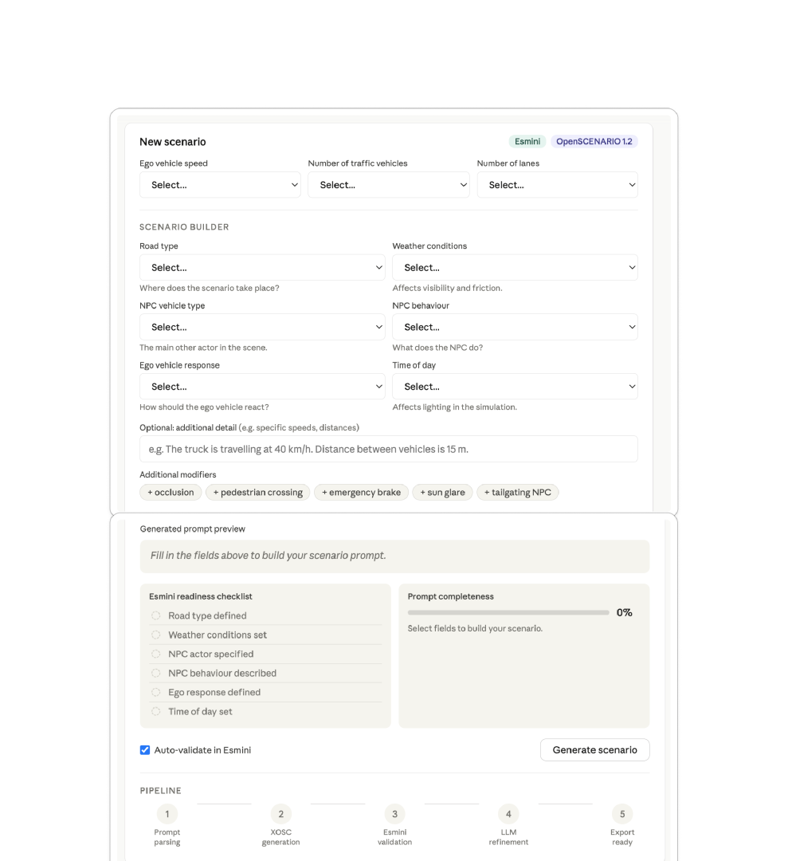
NARRATIVE XAI EXPLAINABLE UI FOR AI DRIVEN DRIVING SCENARIO GENERATION | RESEARCH DESIGN SKETCH
MUHAMMAD MOSTAFIZUR RAHMAN
MODULAR SELECTION UI
Diagram generated with Claude Sonnet 4.5 (Anthropic, 2025). Content reflects authors' own design.
42
Notes:
Here's what that actually looks like. Users fill in dropdowns for road type, weather, NPC behavior, ego vehicle response, and time of day. There's also a free-text field for optional details. Below that, a live prompt preview builds automatically, and a readiness checklist shows what's still missing. At the bottom you can see the five-step pipeline the scenario goes through before it's export-ready.

Slide 43
NARRATIVE XAI EXPLAINABLE UI FOR AI DRIVEN DRIVING SCENARIO GENERATION | RESEARCH DESIGN SKETCH
MUHAMMAD MOSTAFIZUR RAHMAN
DETAILED PARAMETER MAPPING
Road & Environment
NPC Behavior
Event Triggers
Manual selection of road types and weather conditions ensures physical constraints are met by the system automatically.
Define if other cars are controllable or system-decided. Set specific conditions like "Lead vehicle brakes suddenly."
Specific high-risk events: Emergency braking, tailgating NPC, or vehicle merging with a small gap.
43
Notes:
There are three main categories of parameters. First, Road and Environment — things like road type and weather. These are critical because the system needs to know the physical constraints upfront. Second, NPC Behavior — whether other cars are manually controlled or system-decided, and what they do. Third, Event Triggers — specific high-risk moments like emergency braking or a vehicle merging with a small gap.

Slide 44
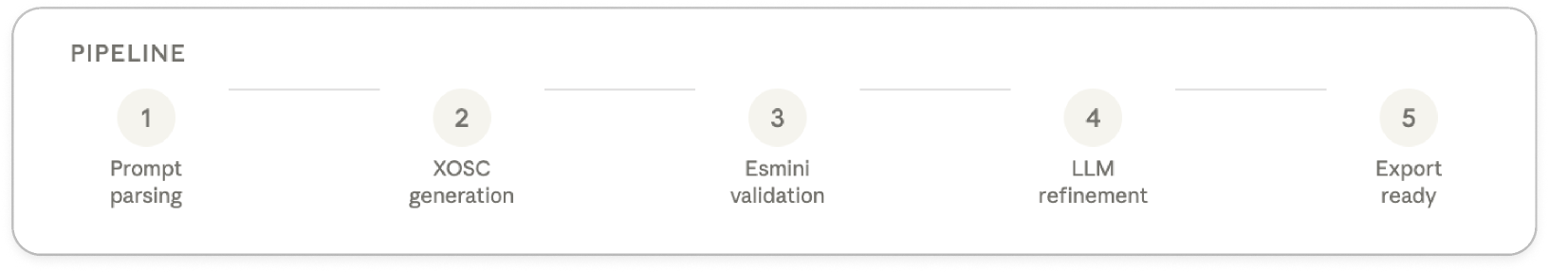
NARRATIVE XAI EXPLAINABLE UI FOR AI DRIVEN DRIVING SCENARIO GENERATION | RESEARCH DESIGN SKETCH
MUHAMMAD MOSTAFIZUR RAHMAN
AUTOMATED SCENARIO PIPELINE
Diagram generated with Claude Sonnet 4.5 (Anthropic, 2025). Content reflects authors' own design.
44
Notes:
Once the user submits their inputs, the system runs through a five-step pipeline automatically. Step 1 is prompt parsing. Step 2 generates the XOSC file. Step 3 validates it in Esmini. Step 4 uses the LLM to refine it. And Step 5 makes it export-ready. The user doesn't need to manage any of this manually.

Slide 45
NARRATIVE XAI EXPLAINABLE UI FOR AI DRIVEN DRIVING SCENARIO GENERATION | RESEARCH DESIGN SKETCH
MUHAMMAD MOSTAFIZUR RAHMAN
ESMINI READINESS CRITERIA
Condition
Requirements
Status
Road Type
Highway/Urban/Rural
Ok
Weather
Clear/Rainy/Fog
OK
NPC Role
Behaviors Assigned
Ok
Trigger Events
Critical situation defined
Ok
Time of Day
Day/night Lighting set
Ok
45
Notes:
For a scenario to be considered valid, it has to meet five criteria in Esmini: road type must be set, weather conditions defined, NPC roles assigned, trigger events specified, and time of day configured. These aren't just nice-to-haves — they're hard requirements for the simulation to actually run.

Slide 46
NARRATIVE XAI EXPLAINABLE UI FOR AI DRIVEN DRIVING SCENARIO GENERATION | RESEARCH DESIGN SKETCH
MUHAMMAD MOSTAFIZUR RAHMAN
Planned measures: EXPERT SCORING FOR QUALITY (ACCEPTABLE: 16/20)
Criteria
1(poor)
3(Moderate)
5(Excellent)
Feasibility
Not possible in sim
Some issues
Fully feasible
Consistency
Contradictions
Minor issues
Fully coherent
Completeness
Missing elements
Parial
All present
Relevance
No match to task
Partial alignment
Fully aligned
46
Notes:
To measure output quality, we'll use expert scoring out of 20. The passing threshold is 16. Experts rate scenarios on four dimensions: feasibility — can it actually run in the simulator; consistency — does it contradict itself; completeness — are all elements present; and relevance — does it match the original task. Each is scored 1 to 5.

Slide 47
NARRATIVE XAI EXPLAINABLE UI FOR AI DRIVEN DRIVING SCENARIO GENERATION | RESEARCH DESIGN SKETCH
COURTNEY HUCK
Planned measures: Task Completion Time
A stopwatch or screen recording timestamp measuring the duration from the participant's first interaction with the tool to the moment they click "Export .xosc".
A stopwatch or screen recording timestamp measuring the duration from the participant's first interaction with the tool to the moment they click "Export .xosc".
If a participant does not complete the task, time-on-task is recorded up to the session cutoff and flagged as incomplete. This metric is observer-logged, not self-reported.
Instrument:
Session Timer
47
Notes:
The first dependent variable we measure is task completion time. We use a session timer — either a stopwatch or screen recording. The clock starts at the participant's first interaction with the tool and stops when they click 'Export .xosc'. If they don't finish, we record however far they got and flag it as incomplete. This is observer-logged, not self-reported.

Slide 48
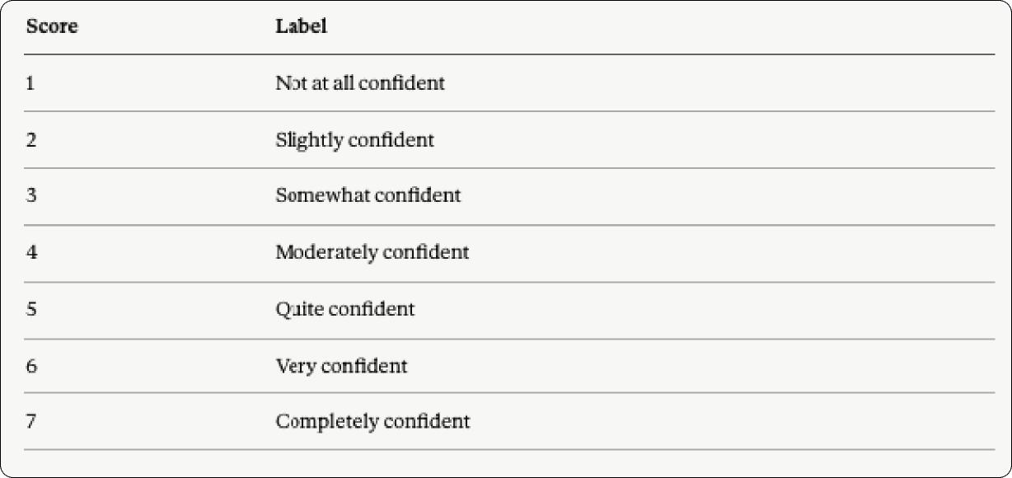
NARRATIVE XAI EXPLAINABLE UI FOR AI DRIVEN DRIVING SCENARIO GENERATION | LITERATURE REVIEW
COURTNEY HUCK
Planned measures: Trust - Likert Scale
"How confident are you that the scenario you just created would run correctly in Esmini?"
*Administered immediately after the task ends to capture in-the-moment confidence
47
Notes:
After the task, we immediately ask participants one question: 'How confident are you that the scenario you just created would run correctly in Esmini?' They answer on a 7-point scale from 'not at all confident' to 'completely confident.' We administer this right after the task ends to capture their in-the-moment feeling, before they overthink it.

Slide 49
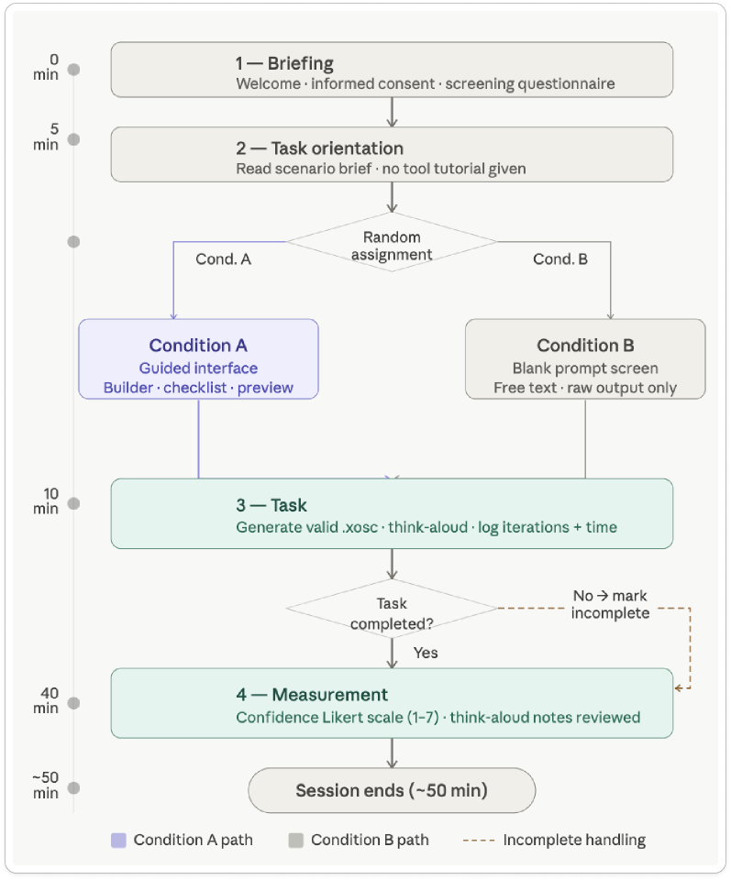
NARRATIVE XAI EXPLAINABLE UI FOR AI DRIVEN DRIVING SCENARIO GENERATION | RESEARCH GAPS
COURTNEY HUCK
Procedure
Outline
Diagram generated with Claude Sonnet 4.5 (Anthropic, 2025). Content reflects authors' own design.
48
Notes:
Here's the full flow of a session. We start with a briefing — consent and screening. Then a brief task orientation where participants read the scenario brief, but we give no tool tutorial, because how they figure it out is part of what we're testing. They're then randomly assigned to Condition A or B and spend about 30 minutes on the task. Afterward we measure confidence with the Likert scale. The whole session ends around 50 minutes.

Slide 50
NARRATIVE XAI EXPLAINABLE UI FOR AI DRIVEN DRIVING SCENARIO GENERATION | RESEARCH GAPS
COURTNEY HUCK
Session Structure (30-50 min)
Time | Activity
0–5 min | Welcome, informed consent, screening questionnaire
5–10 min | Brief orientation to the task (no tool tutorial since it’s part of the test)
10–40 min | Task on assigned condition
40–50 min | Likert confidence/trust rating
49
Notes:
To summarize the timing: the first 5 minutes are welcome and consent. Minutes 5 to 10 are task orientation. Minutes 10 to 40 are the actual task. And the final 10 minutes are for the confidence rating. Total session length is 30 to 50 minutes depending on the participant.

Slide 51
NARRATIVE XAI EXPLAINABLE UI FOR AI DRIVEN DRIVING SCENARIO GENERATION | RESEARCH GAPS
MUHAMMAD MOSTAFIZUR RAHMAN
Realism & Feasibility
Users who employ a structured LLM prompt template with predefined task parameters will produce a lower proportion of unrealistic or infeasible scenarios than engineers who begin from a blank prompt screen
Logical Guardrails: Structured parameters enforce logical constraints upfront, mitigating the model's freedom to hallucinate wild parameters.
Eliminating Latent Gaps: Blank prompt screens force reliance on implicit context, leading to frequent logic gaps in scenario models.
Outcome Verification: By defining input constraints clearly, generated scenarios achieve a significantly higher proximity to real-world applicability.
45

Slide 52
NARRATIVE XAI EXPLAINABLE UI FOR AI DRIVEN DRIVING SCENARIO GENERATION | RESEARCH GAPS
MUHAMMAD MOSTAFIZUR RAHMAN
Establishing Trust
Users who apply a structured LLM prompt template with predefined task parameters will report higher trust in the LLM-generated scenarios than engineers who begin from a blank prompt screen
Cognitive Consistency: Repeatable structures provide expected predictability, increasing the user's reliance on generated scenarios.
Lowered Cognitive Stress: Removing the blank slate anxiety shifts the user's role from "accidental prompter" to authoritative curator.
Systemic Reliability: Prompt templates make the input-to-output pipeline traceable, framing the LLM as a trustworthy research partner.
45

Slide 53
MINHAS
Risks, Open Questions & Next Steps
06

Slide 54
NARRATIVE XAI EXPLAINABLE UI FOR AI DRIVEN DRIVING SCENARIO GENERATION | RESEARCH GAPS
LLM generates syntactically invalid XOSC that Esmini cannot parse
The LLM may produce OpenSCENARIO XML that is structurally malformed, uses unsupported tags, or references actors that haven't been declared - all of which cause Esmini to fail silently or crash rather than returning a useful error.
Mitigation: Build a lightweight XOSC schema validator as an intermediate step between LLM output and Esmini validation. Additionally, use few shot prompting in the LLM system prompt provide 2–3 known valid XOSC examples as context so the model has a concrete structural template to follow.
Risk 1
51

Slide 55
NARRATIVE XAI EXPLAINABLE UI FOR AI DRIVEN DRIVING SCENARIO GENERATION | RESEARCH GAPS
Participant recruitment is harder than expected for 0–2 year engineers
Unlike recruiting students, early career professionals are harder to reach, have less flexible schedules, and may need employer approval to participate in external studies.
Mitigation: Target THI’s industry partner networks and any engineering graduate groups. Prepare a one-paragraph plain-language study description that can be shared quickly. Also define a fallback participant profile for final year engineering students with some simulation exposure, if needed.
Risk 2
52

Slide 56
NARRATIVE XAI EXPLAINABLE UI FOR AI DRIVEN DRIVING SCENARIO GENERATION | RESEARCH GAPS
The guided interface itself introduces a demand characteristic bias
Participants in Condition A may produce higher confidence ratings (H3) simply because the interface looks more professional and complete than the blank screen, but not because the underlying scenario is better. This would inflate H3 results and make it difficult to attribute confidence gains to the interface's functional features rather than its aesthetic polish.
Mitigation: In the task brief and verbal introduction, frame both conditions neutrally. Describe them as "two different versions of the tool" rather than implying one is more developed. Additionally, a think aloud protocol could help here if participants in Condition A verbalize confidence based on appearance rather than the checklist or validation feedback; this will be visible in the qualitative data and can be noted as a limitation in findings.
Risk 3
53

Slide 57
Q&A
Should we remove the Quality Assurance hypothesis? Instead, should we just focus on Time & Confidence?
(If we did this, we’d probably include a SUS (System usability scale) survey at the end of the session to gain more qualitative data on users’ confidence on the tool?)
Should we remove the “Additional Modifiers” section of the interface?
(Although it would give the engineers more options, that section of the tool doesn’t directly tie into our hypotheses as strongly as the other parts of the tool)
Can our interface be local? Or does it need to be accessible on the web?
54
Notes:
Can our interface be local? Or does it need to be accessible on the web.

Slide 58
Next Milestone - Prototype
Connect the prompt builder to the LLM backend and implement the XOSC generation step.
Implement the five-step pipeline status panel with live state transitions.
Integrate Esmini validation and the auto-refinement loop.
Build the guided scenario builder fields with live prompt preview and readiness checklist.
Conduct internal end-to-end testing before submission.
55

Slide 59
Next Milestone - Study Plan
Finalize and write up the full study design including the between-subjects A/B structure, Condition A (guided interface) and Condition B (blank prompt screen), and the rationale for each design decision
Determine how we will recruit potential users
Finalize the session procedure outline (briefing → task orientation → random assignment → task → measurement → session end) with timing for each phase
Finalize measures and instruments that will be used for testing.
Write the screening questionnaire covering years of experience, prior simulation tool exposure, LLM familiarity, engineering background, and AV systems familiarity
56

Slide 60
Block D - Minhas
A clear, visually highlighted slide titled "Research Gaps" listing 3–6 specific gaps you
derived from Block C.
Each gap should be one short sentence and traceable back to the literature you just
showed.
A short narrative slide explaining which gap(s) your team will pursue and why this scope
is feasible in one semester.

Slide 61
NARRATIVE XAI EXPLAINABLE UI FOR AI DRIVEN DRIVING SCENARIO GENERATION | CONCEPT DESIGN
DISHA MANJUNATHA SHENOY
Backmatter
07

Slide 62

Contributions
Courtney - Block D & Block E Disha - Block E & Block G
Sirine - Block C
Minhas - Block F
Mosta - Block E Sadia - Block B
Pranta - Block A
Presentation - Prepared by all team members
58

Slide 63
References
[1] A Survey on the Application of Large Language Models in Scenario-Based Testing of Automated Driving Systems, 2025. arXiv.
[2] OmniTester: Multimodal Large Language Model Driven Scenario Testing for Autonomous Vehicles, 2024. arXiv.
[3] Prototyping with Prompts, CHI 2025. arXiv.
[4] Prompt-with-Me: In-IDE Structured Prompt Management, 2025. arXiv.
[5] Text2Scenario: Text-Driven Scenario Generation for Autonomous Driving Test, 2025. arXiv.
59

Slide 64
Figures & Assets Credits
All interface mockups, system diagrams, user journey flowcharts, and procedure outline diagrams presented in this work were generated using Claude Sonnet 4.5 (Anthropic, 2025) via the Claude.ai web interface. Diagrams were produced through an iterative, conversational design process and refined by the research team. All content reflects the authors' own research design decisions.

